Slide 1
Recommendation Engine
Amazon ML Hiring Challenge

Slide 2
Model Based Recommendation System
Extract data from small portion of dataset.
Build a model without using whole dataset.
Use the model to make predictions.

Slide 3
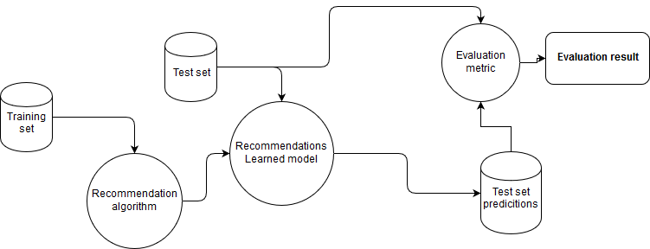
Architecture

Slide 4
Advantages
Scalable Recommendation Engine.
Faster Prediction Speed.
Predicting on larger dataset using smaller dataset.
Avoidance of Overfitting.

Slide 5
Disadvantages
Difficult to add new data making model inflexible.
Quality of predictions will depend upon the model built.

Slide 6
Approach used in the challenge
Have used datasets provided in the challenge.
Cleaned data and filled NA values with medians in numerical features and modes in categorical features.
Selected features having correlation coefficients within range -0.5 and 0.5 and done One Hot Encoding for categorical features.
Scaled data and used SVM Classifier to built generalized model having 96% accuracy on train data and 97% accuracy on validation data.
Predicted using the model having 97% precision on validation data.
Model predicted classes using 93.79% precision on test data.

Slide 7
Thank You

